Slide 1

Rescue Diving

Slide 2
The Paperwork
Student Folder
Liability Release
Medical Statement

Slide 3
Introductions
Professional Staff
Participants
Your name ?
What type of diving experience do you have ?
Which diving activities interest you the most ?
What brings you here today ?

Slide 4
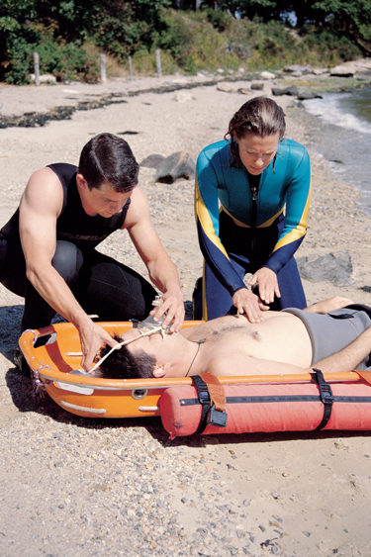
About this Program
Specialty Certification
SDI Rescue Diver Certification

Slide 5
About this Program
A Few Things to Discuss
SDI Manual
Scuba IQ Reviews
Class Sessions
Open Water Dives

Slide 6
Any Questions ?

